Slide 1
Accelerated Learning Initiative Reactjs – Props , states and Routing

Slide 2
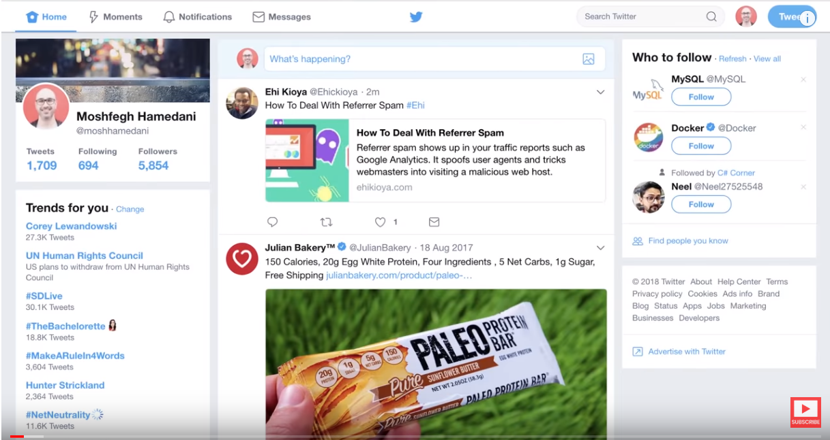

Slide 3
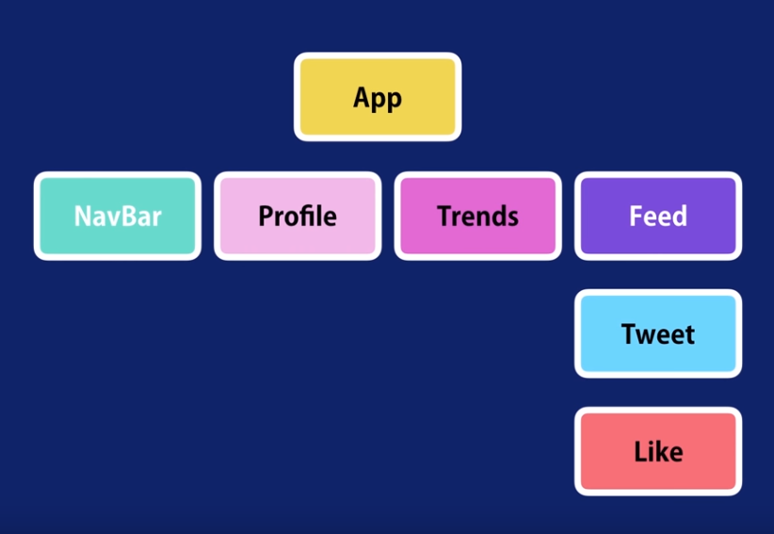

Slide 4

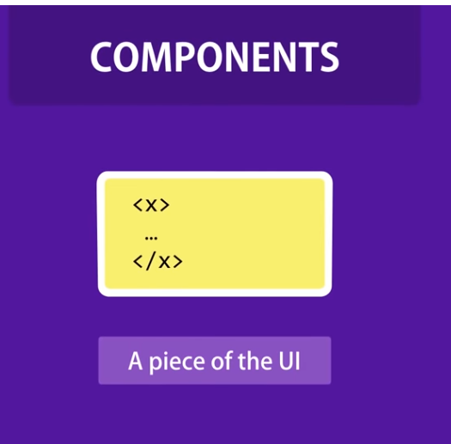
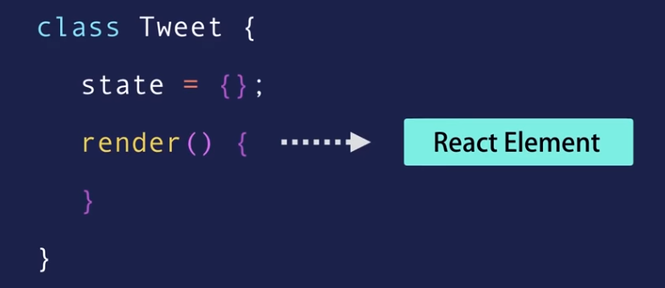
REACT IS
Notes:
React is JavaScript library for building fast and interactive user interfaces developed by Facebook
At the heart of react is a component which is a piece of UI code
When building react app we build Independent , isolated reusable components and compose them to build complex user interfaces
Output of component is a react element which is nothing but a JavaScript object in memory

Slide 5
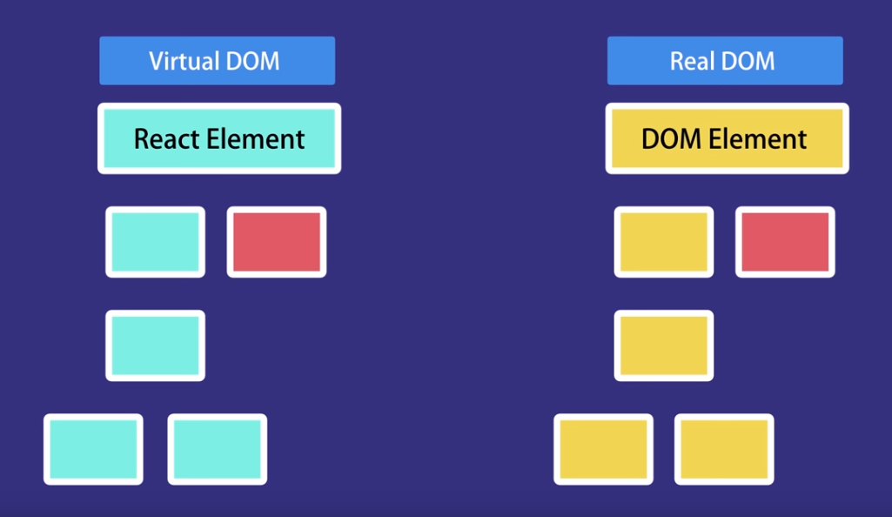
New State
Updated State
Old State
Notes:
Output of component is a react element which is nothing but a JavaScript object in memory
React elements are light weight representation of the DOM elements in memory
Whenever there is state change to a component , it creates a new component in memory , then react compares the changed value and updates the real DOM only with what is changed. That’s why it is called react , we no longer need to work with DOM APIs and event handlers
const element = Doument.querySelector
Element.addEventListner()
React , reacts to the state change of the component and updates the actual DOM

Slide 6
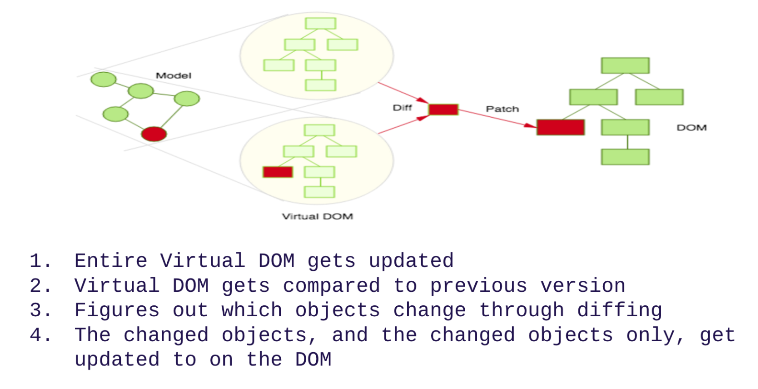

Slide 7
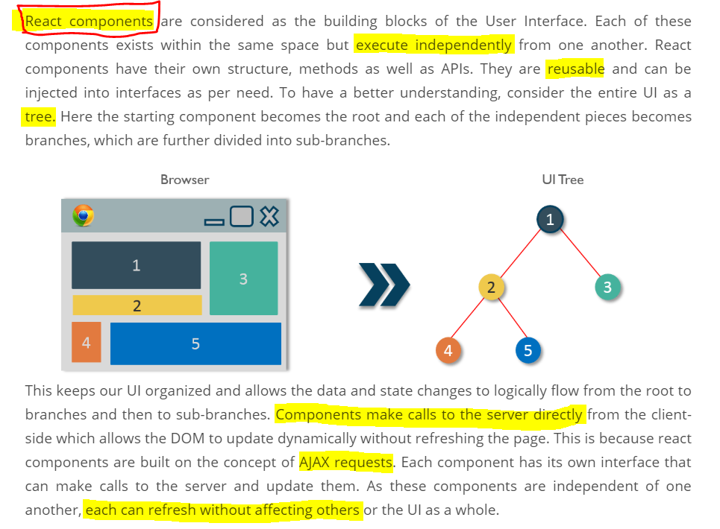

Slide 8
Data for react components are stored in 2 places
PROPS
STATES

Slide 9
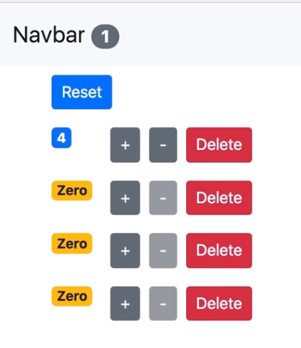
What we are going to Build

Slide 10

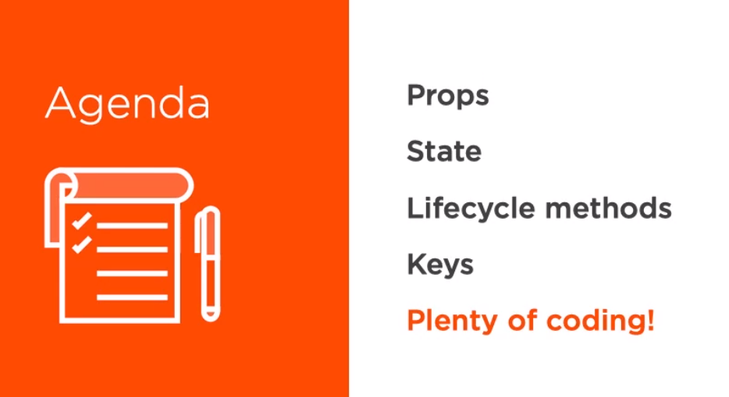

Slide 11
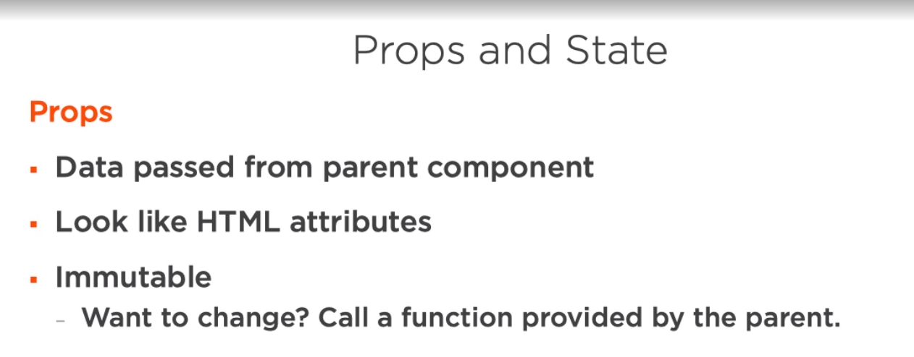
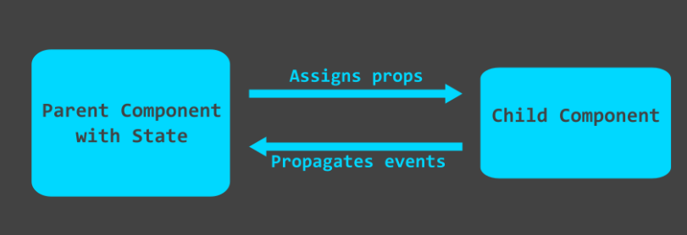
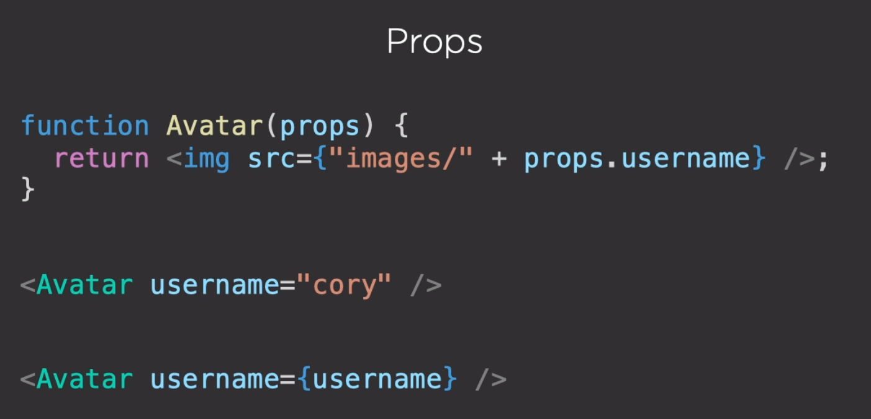

Slide 12
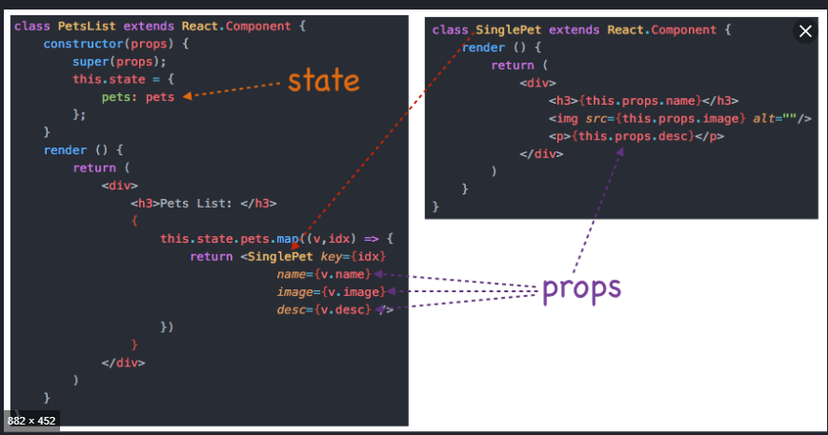
CHILD
PARENT

Slide 13
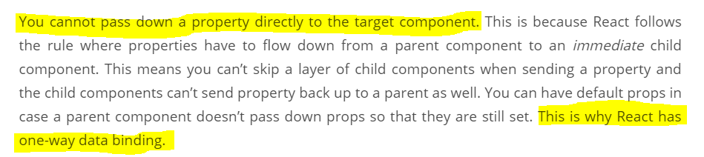
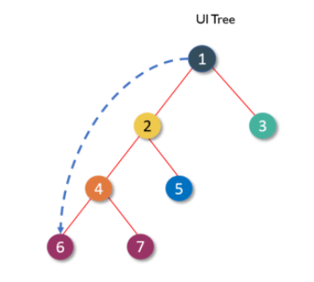
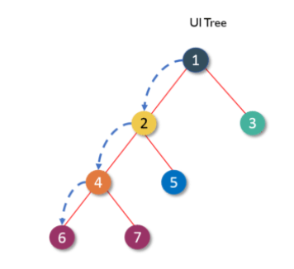

Slide 14
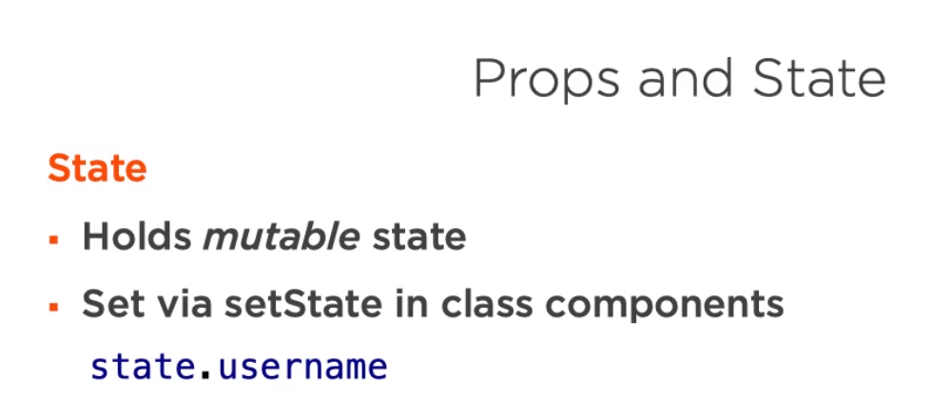
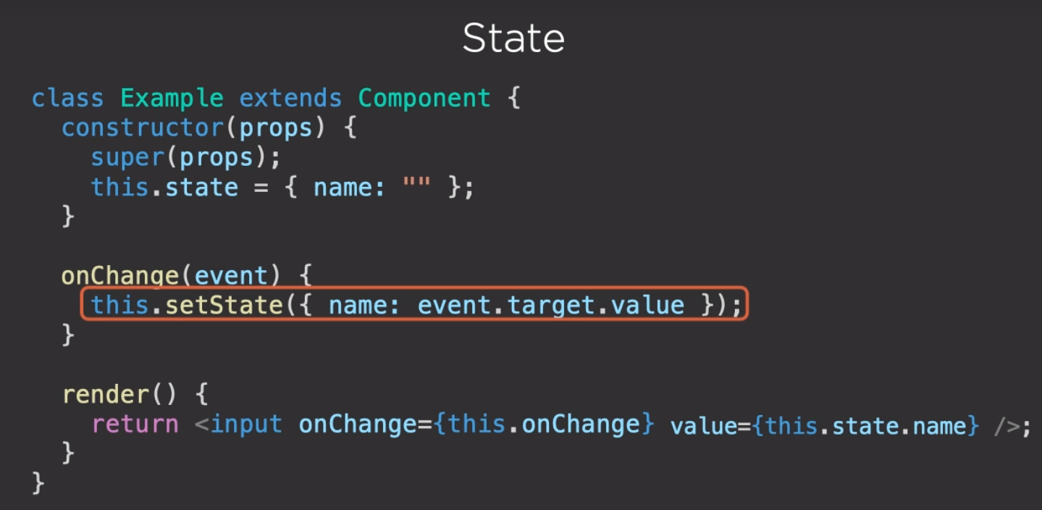
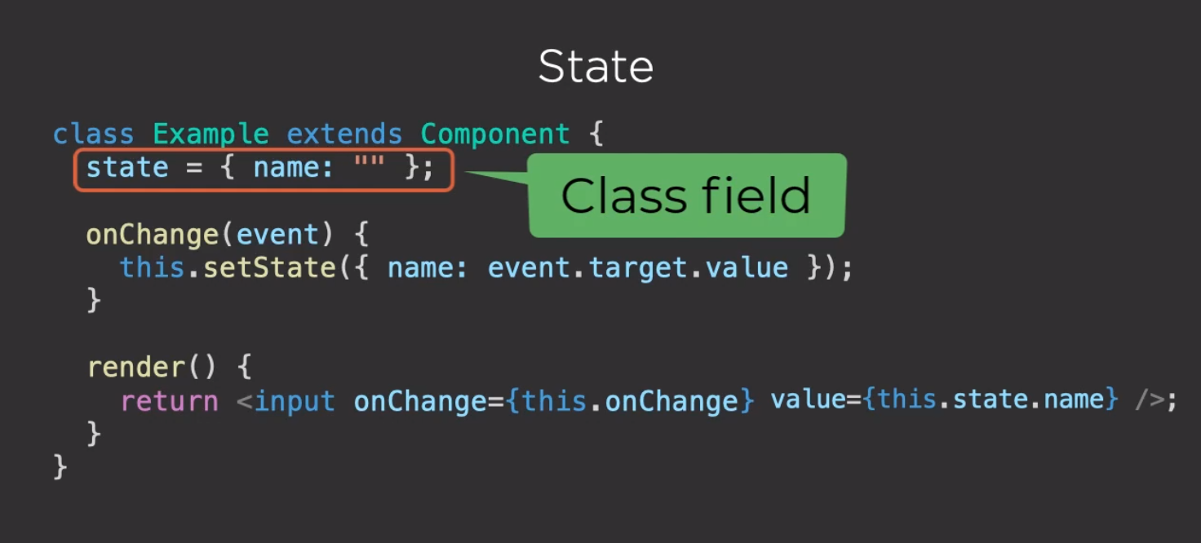

Slide 15
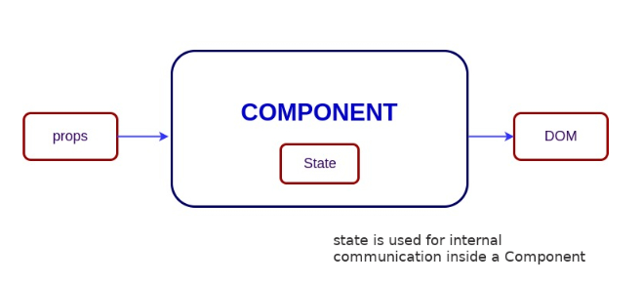
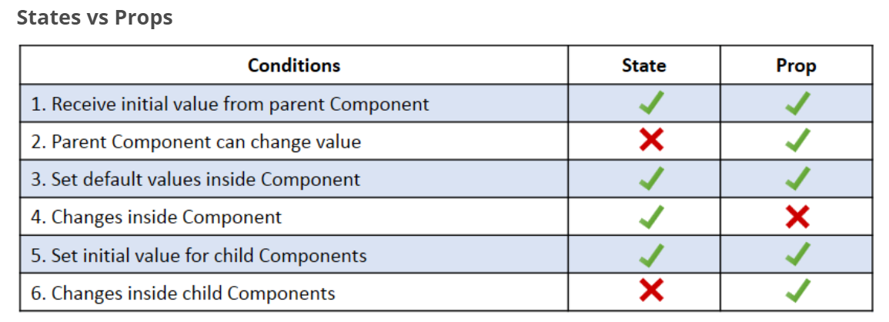

Slide 16
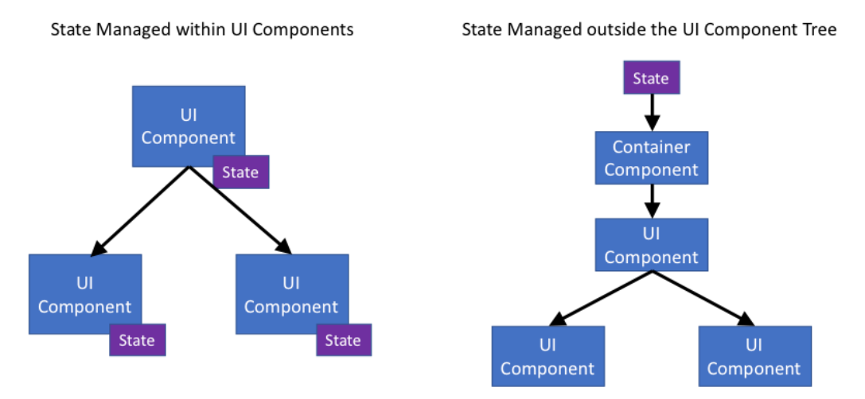

Slide 17
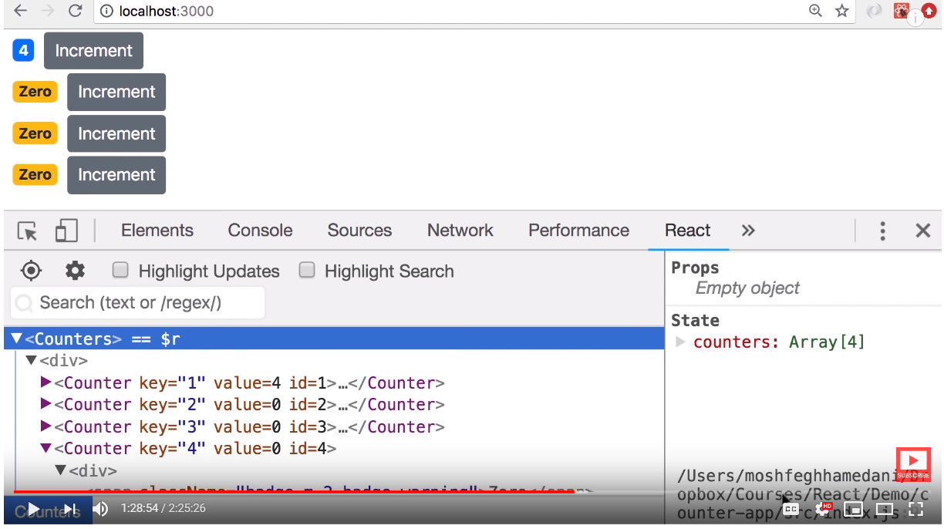
Debugging React App

Slide 18

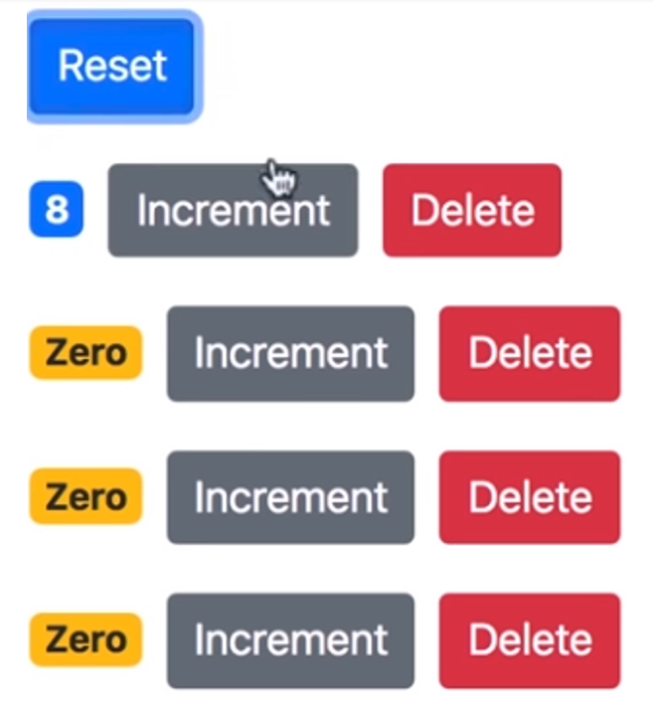
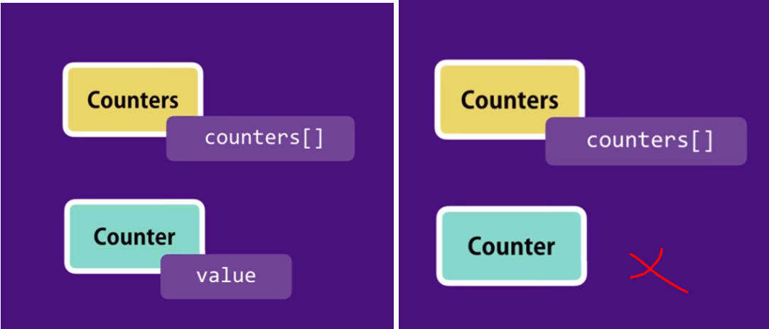
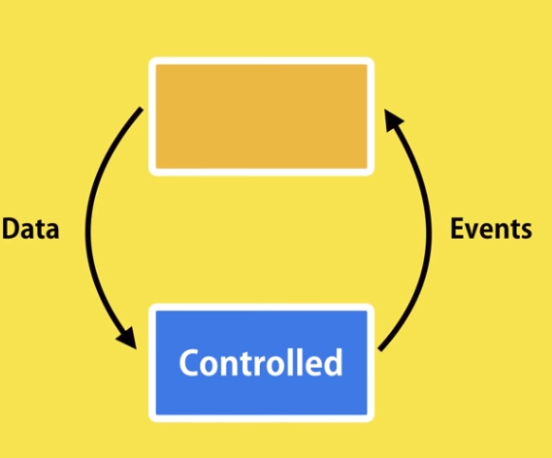
Notes:
When we click on increment, we can access local state and increase the counter value
But when we click on reset button, we can not reset the counters of all counters as we do not have access to the state of the child components
In order to achieve this we need to remove local state and have a single source of truth
Remove local state and pass the data from parent, such components are called controlled component which are completely controlled by parent and can only raise events

Slide 19
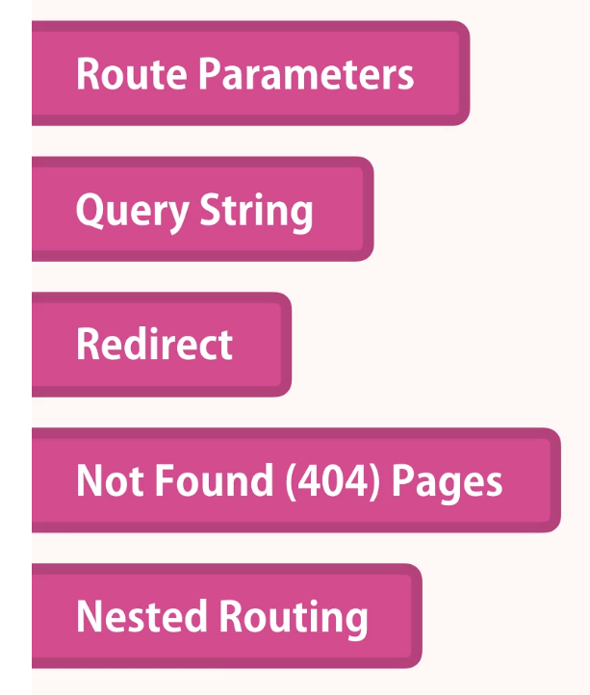

Slide 20
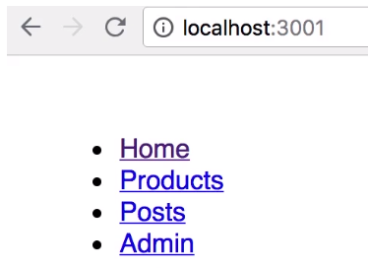

Slide 22
REFERENCE
Sadsa
Asdsa
https://www.edureka.co/blog/react-components/

